Slide 1
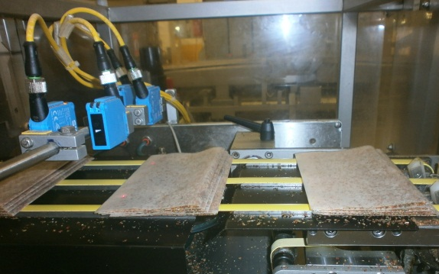
Example of a Brainstorming Session on the Problem: "Laminate Jamming in the Packaging Machine"
Paper misalignment
Laminate sheet misalignment
Non-compliant laminate quality
Non-compliant paper quality
Poor paper fold quality
Incorrect Eurosicma settings/parameters
Misaligned paper relative to the laminate
Incorrect conveyor positioning at the output
Dust or contamination in the area
Cleanliness of sealing jaws
Temperature of sealing jaws
Malfunction of the rejector before Eurosicma
Incorrect dosage
Non-compliant folding rollers for envelopes
Incorrect paper placement by the robot
Absence of a controller
Malfunction of the corrector
Low operator qualification
Low controller qualification
Unsuitable climate conditions (humidity, temperature) in the facility
Misaligned pulling belts
Laminate adhesion (transition from one roll to another)
Uneven paper placement in the cassette
Misalignment during transfer between conveyors under crosscutting knives
1
2
3
4

